Slide 1
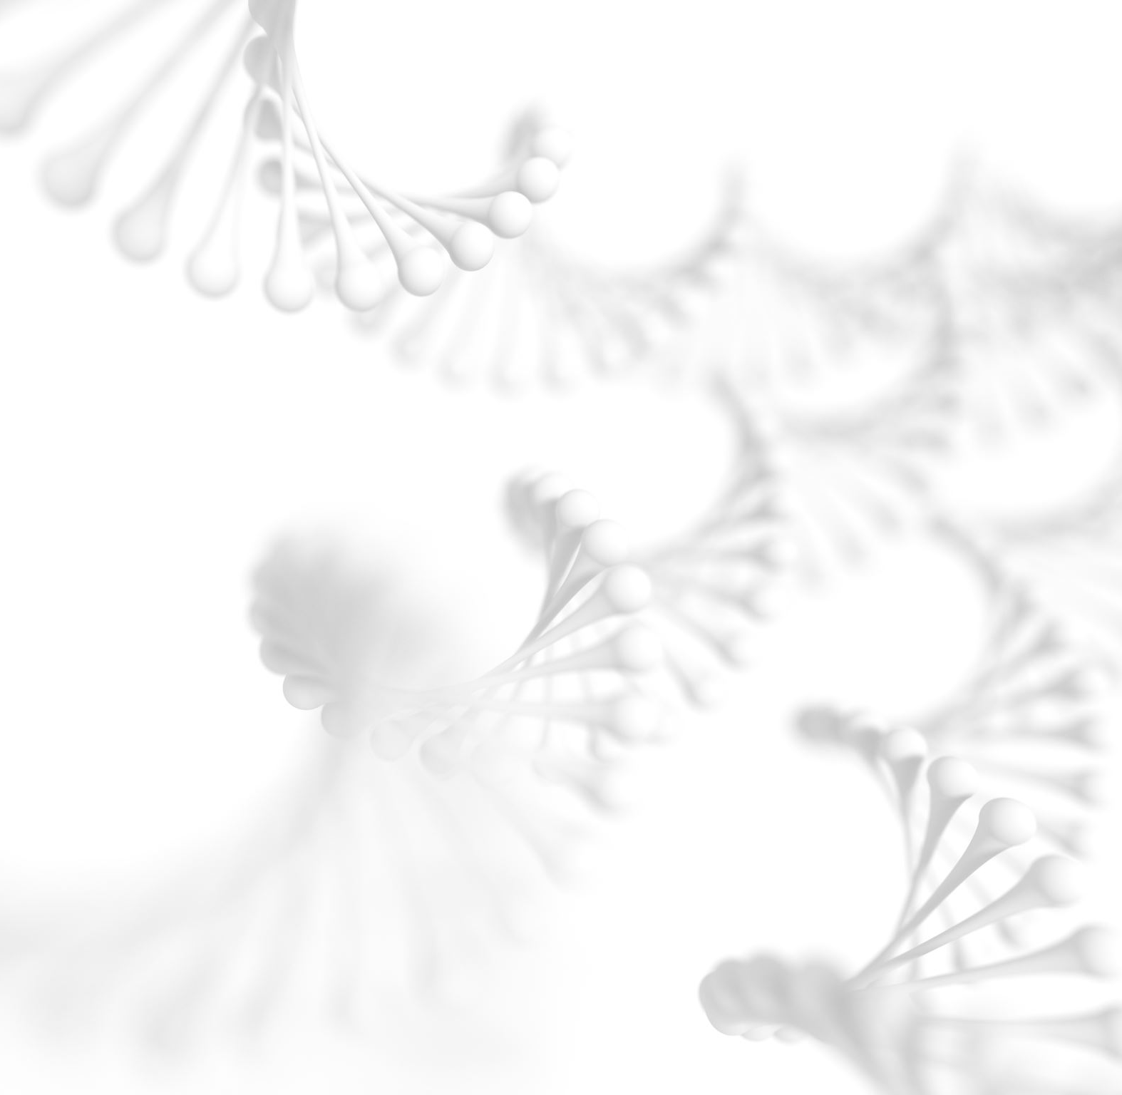
Beyond the Genome
Chandler Sutherland
Krasileva Lab, Department of Plant and Microbial Biology, UC Berkeley
Notes:
My name is Chandler Sutherland, and I am a third year graduate student and Plant Biologist at UC Berkeley
I’m from the bay area, san jose, and went to Berkeley for college where I studied molecular biology and joined a research lab where I studied genetics of algae
I now work on plant immune systems, and one of the main tools I use for my work is sequencing and genomics, which I am going to talk to you all about today and show you some of the work I do in the lab to sequence.
I’m happy to answer questions throughout the presentation or at the end, whatever you feel more comfortable with
Just to get a feel for the room, show of hands for who has taken biology class at nueva
What sort of class
What do you think when I say genome, doesn’t have to be right or wrong, but what comes to mind
Today we are going to go through a brief history lesson on sequencing in general, then get to the state of the art, including a sequencing device. Then you are going to get to process some sequencing data yourself!

Slide 2
Letter
Nucleotide: building block of DNA, consisting of sugar molecule and a nucleotide base
Sequence: a string of nucleotides
Genome: the complete set of genetic material (DNA) in an organism
Genomics: study of the structure, function, evolution, and editing of genomes
Word
Book
Library
Notes:
Starting off with some definitions, a genome is the complete sequences of DNA in an organism, from end to end of a chromosome, containing all the genetic code for inheritance of an organism
Genomics is the field of biology that has grown around the new-ish ability to sequence genomes, and it uses this sequence information to learn about structure of genomes and of proteins that they encode, help determine the function of genes, how genes evolved and also how species evolved, and how we can edit these genomes.
Genomics is a very exciting place to do research because tools are constantly being developed, discoveries are being made, and the most exciting part of science is that there are so many unknowns
Determining the order of the DNA bases, or sequencing, allows researchers to decode the first layer of genome features such as protein-coding genes, repetitive areas called “repeats,” and the elements that regulate how genes are expressed in cells. Together, all of these features provide the genetic instructions that make each plant species unique.

Slide 3
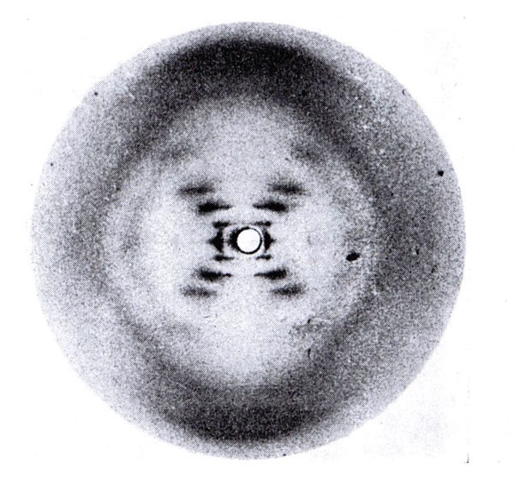
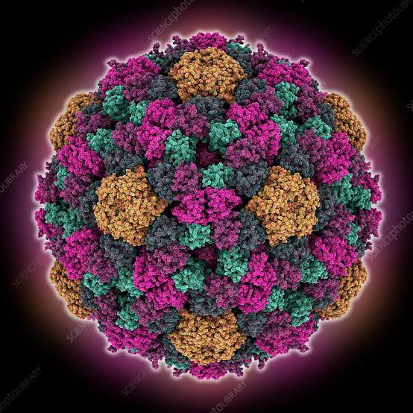
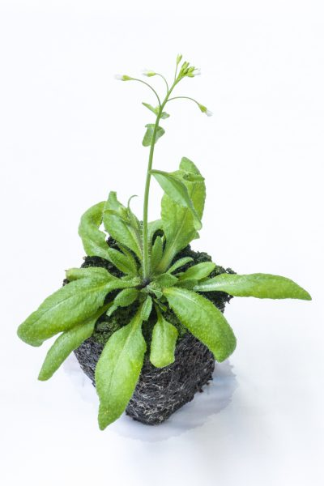
A Brief History of Sequencing
1869: Discovery and Isolation of DNA
1953: Structure of DNA determined
1965: First DNA Sequence
1977: First genome
1996: Sequencing by fluorescently labeled dyes
2000: First plant genome sequenced
2014: Nanopore long read sequencing
2021: Human genome finished end to end
Notes:
1869 Frederick Meisher discovered DNA. But it was largely ignored, because proteins were thought to be the source of genetic inheritance. Largely a decade progressed without any major improvements
In 1953, Rosalind Franklin discovered the structure of DNA and how the four nucleotides bind together, and interest was renewed in determining sequences of DNA
It would be ten more years before the first DNA sequence, which was a partial gene fragment from a virus.
In the 70s, the first generation of sequencing was born, Sanger sequencing, where radioactive dyes were added to DNA as it lengthened and manually counted and ordered. The capability was still very limited, but allowed for the first genome, all the DNA of a virus, to be sequenced.
Can you guess what the first genome that was sequenced was? Brings up an interesting point about genome size and ease of sequencing. For example, people in my lab are actively sequencing the wheat genome, which is 5x larger than the human genome!
What is called next generation sequencing began in 1996 with the technology which is now behind what we call illumina sequencing was developed, where fluorescently labeled dyes are added in rapid succession and decoded by computers
This breakthrough was sufficient for the first draft of the human genome to be sequenced
The latest advancements in sequencing are long read capabilities, which allow for new advancements in speed and structure of DNA to be discovered, including PacBio and Nanopore sequencing which we will be observing today.
Interestingly, the human genome was not completely sequenced until May of 2021, and even still there are stretches that are not completely confirmed

Slide 4
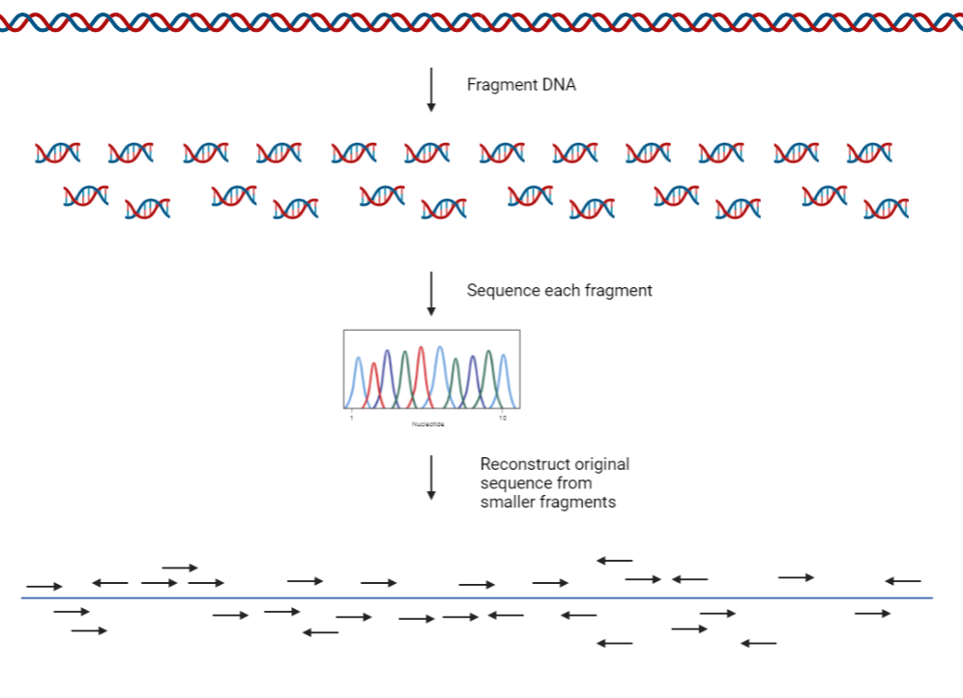
Notes:
Standard sequencing process includes isolation of DNA from an organism, breaking up the DNA into smaller chunks, sequencing each fragment, and then working backwards from the fragments to build back the genome
Using our book analogy, the book of all the DNA sequences in the genome is run through a shredder, leaving only sentences. You have to reconstruct the book by looking at where the sentences overlap and make sense, but it takes a ton of work the first time around! Once you have a reference genome, it’s easier to add other genomes because you have something to compare to. The longer your sentences, the easier it is to reconstruct

Slide 5
Dominant Sequencing Technologies
1
2
3
Short read sequencing by synthesis (Illumina)
>90% of world’s sequencing data
Each read (sequence-able fragment of DNA) is only 100-350 nucleotides long
Very accurate
Long read sequencing (PacBio)
Rapid sequencing (3 DNA molecules per second)
Long reads – up to 20,000 nucleotides
Somewhat accurate
Long read sequencing (Oxford Nanopore)
Small, portable, USB-powered
Long reads (up to 1,000,000s nucleotides)
Field applications, including missions in space
Notes:
Now remember, the human genome is 3.1 billion nucleotides. So when your reads are only 100 nucleotides, it can be very difficult to put them where they are supposed to go, especially in areas of the genome that are repetitive
Long read sequencing is newer and very exciting, but can be less accurate. Many of the best sequencing approaches use a combination of technologies to achieve high accuracy and reconstruction
What we will be demonstrating today is nanopore, which I can run from my laptop and use in lab. The other two technologies require special sequencing facilities

Slide 6
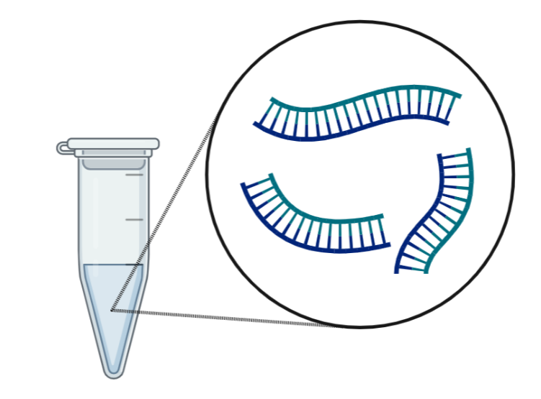
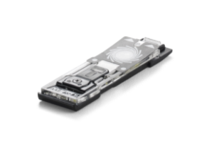
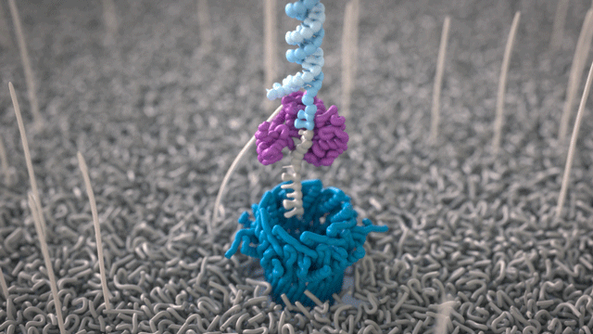
Flow Cell
Nanopores
Notes:
DNA is loaded onto a flow cell, which contains nanopores. Nanopores are protein channels that expand and contract around each of the base pairs. DNA is feed through each of these pores
126 pores are in the flow cell we are using today

Slide 7
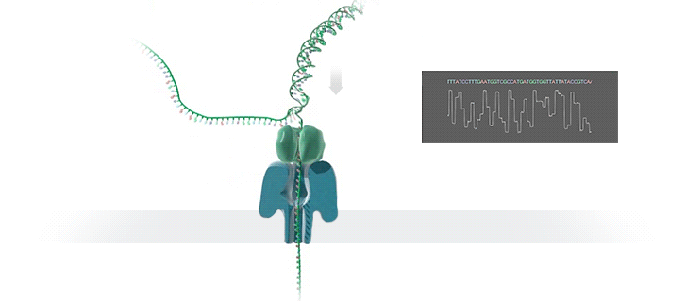
As each strand of DNA is passed through a nanopore, an electrical signal is recorded that can be used to decode the sequence
Notes:
As the pore expands and contracts around each unique nucleotide, it emits an electrical signal that is recorded by a computer, which can be decoded to create sequences

Slide 8
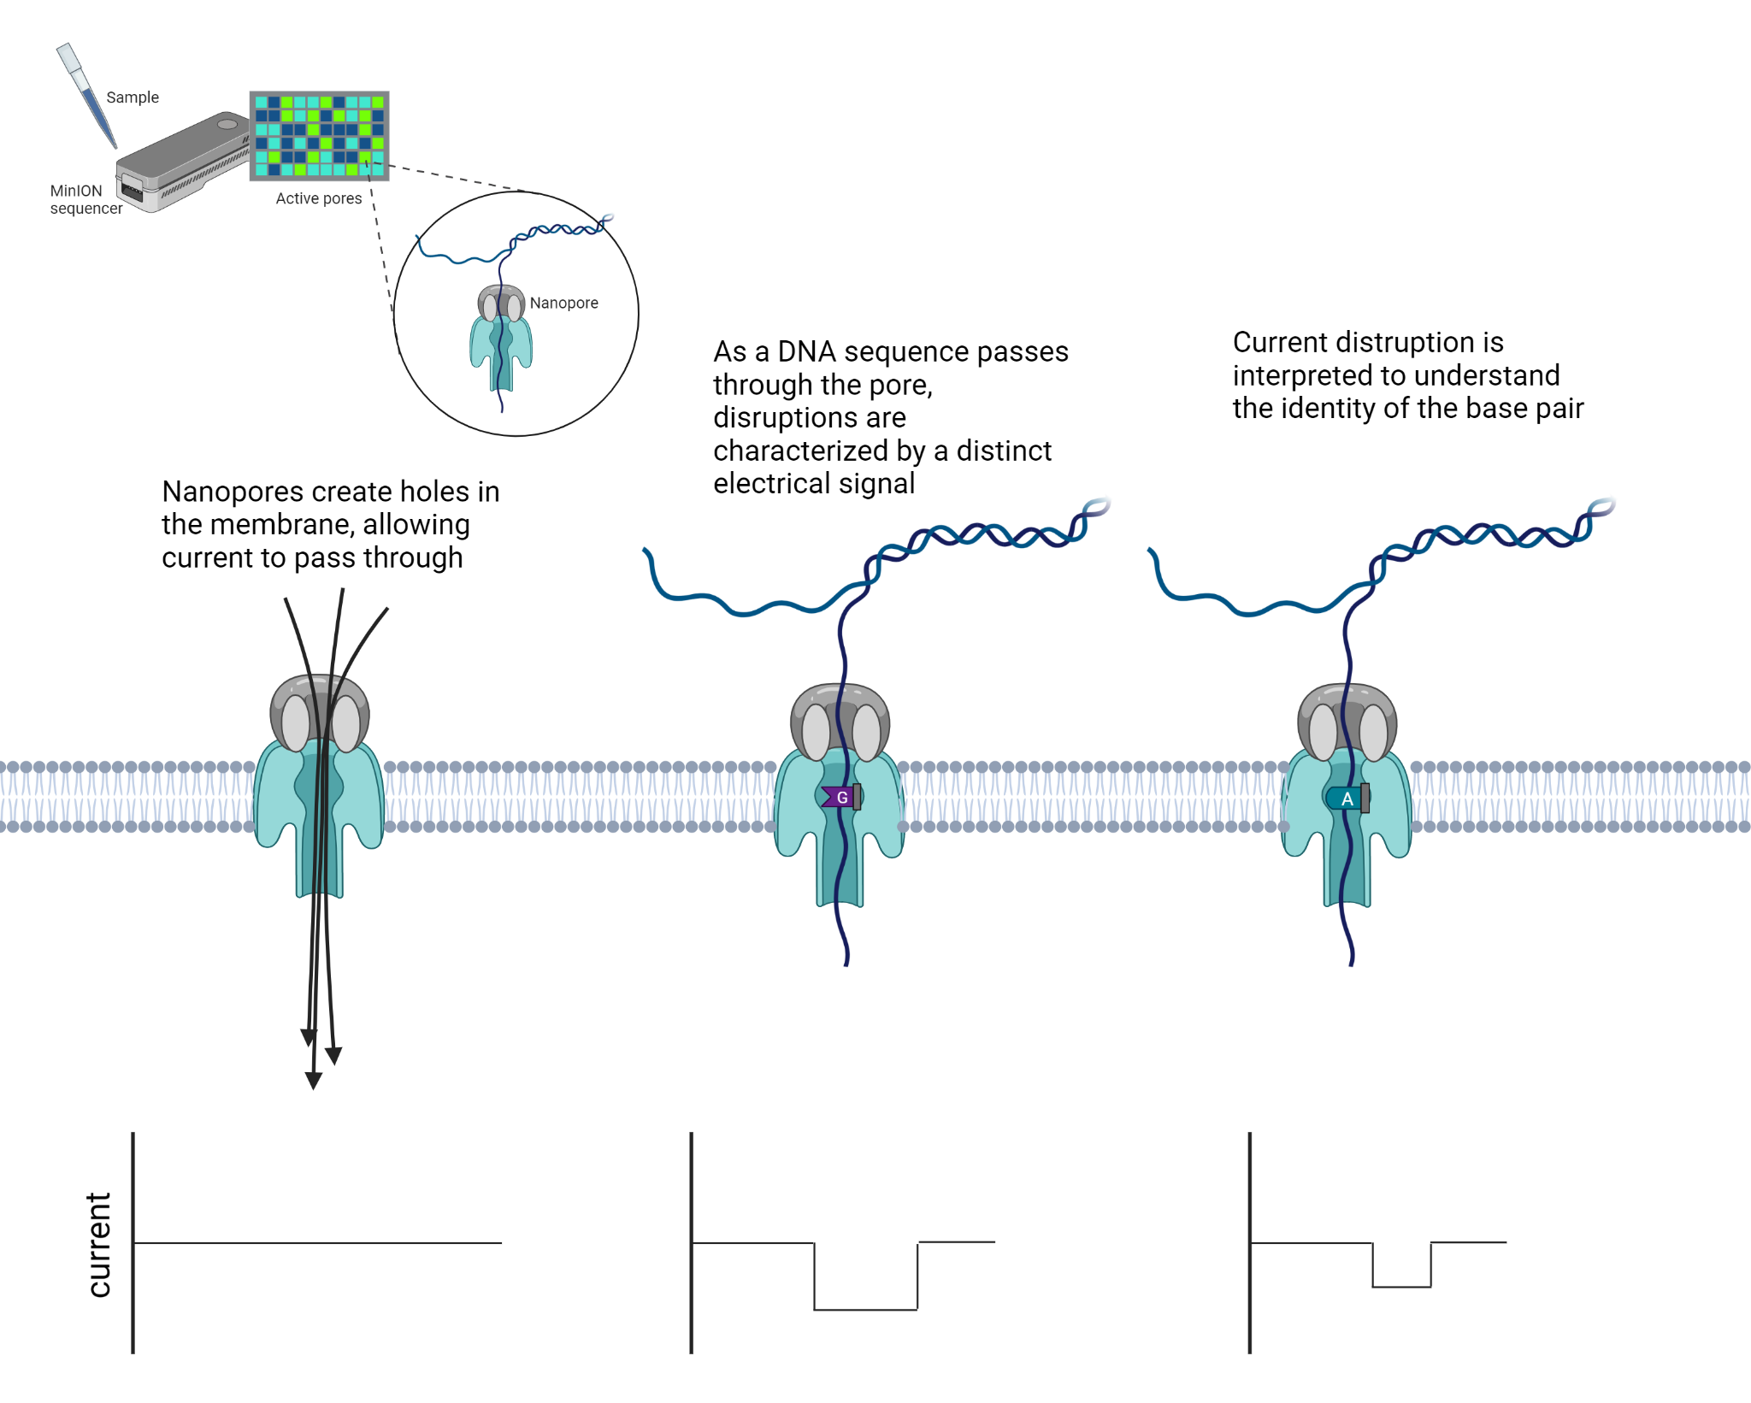
Nanopore sensing
Notes:
The current is measured by electronic sensors embedded in the flow cell, which is then saved as a datafile on the computer and can be transformed into sequence data

Slide 9
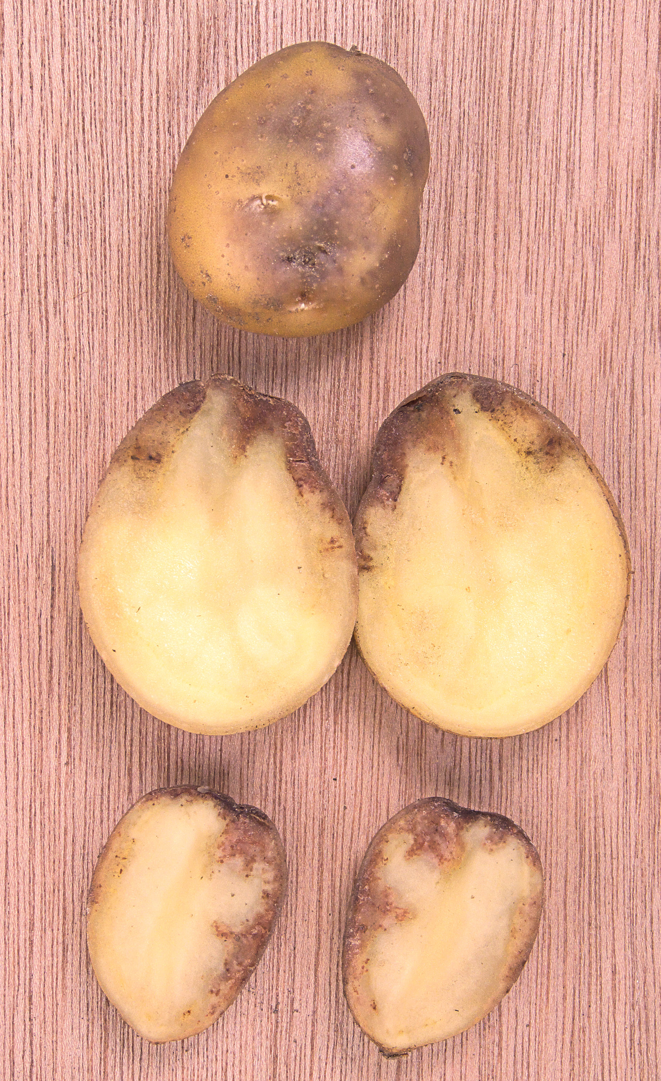
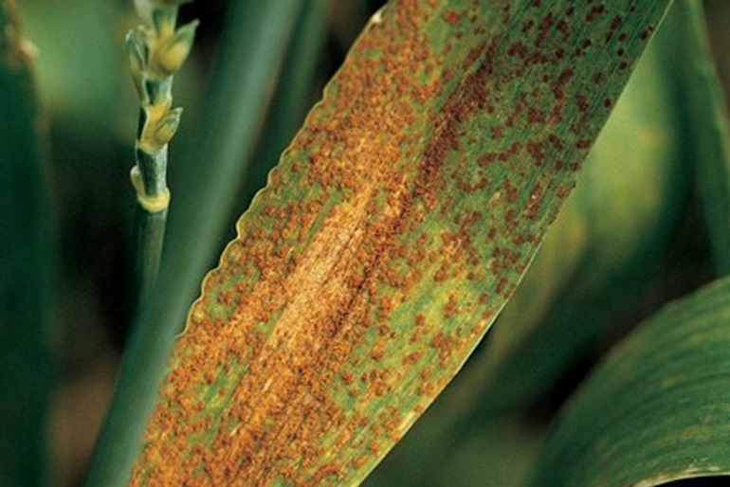
Notes:
Now let’s talk a little more about the DNA we are going to be processing together

Slide 10
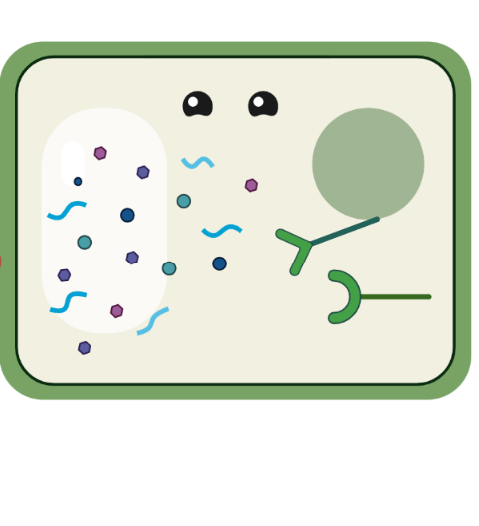
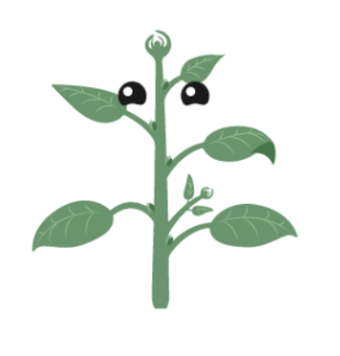

Plant Recognition of Pathogens

Slide 11
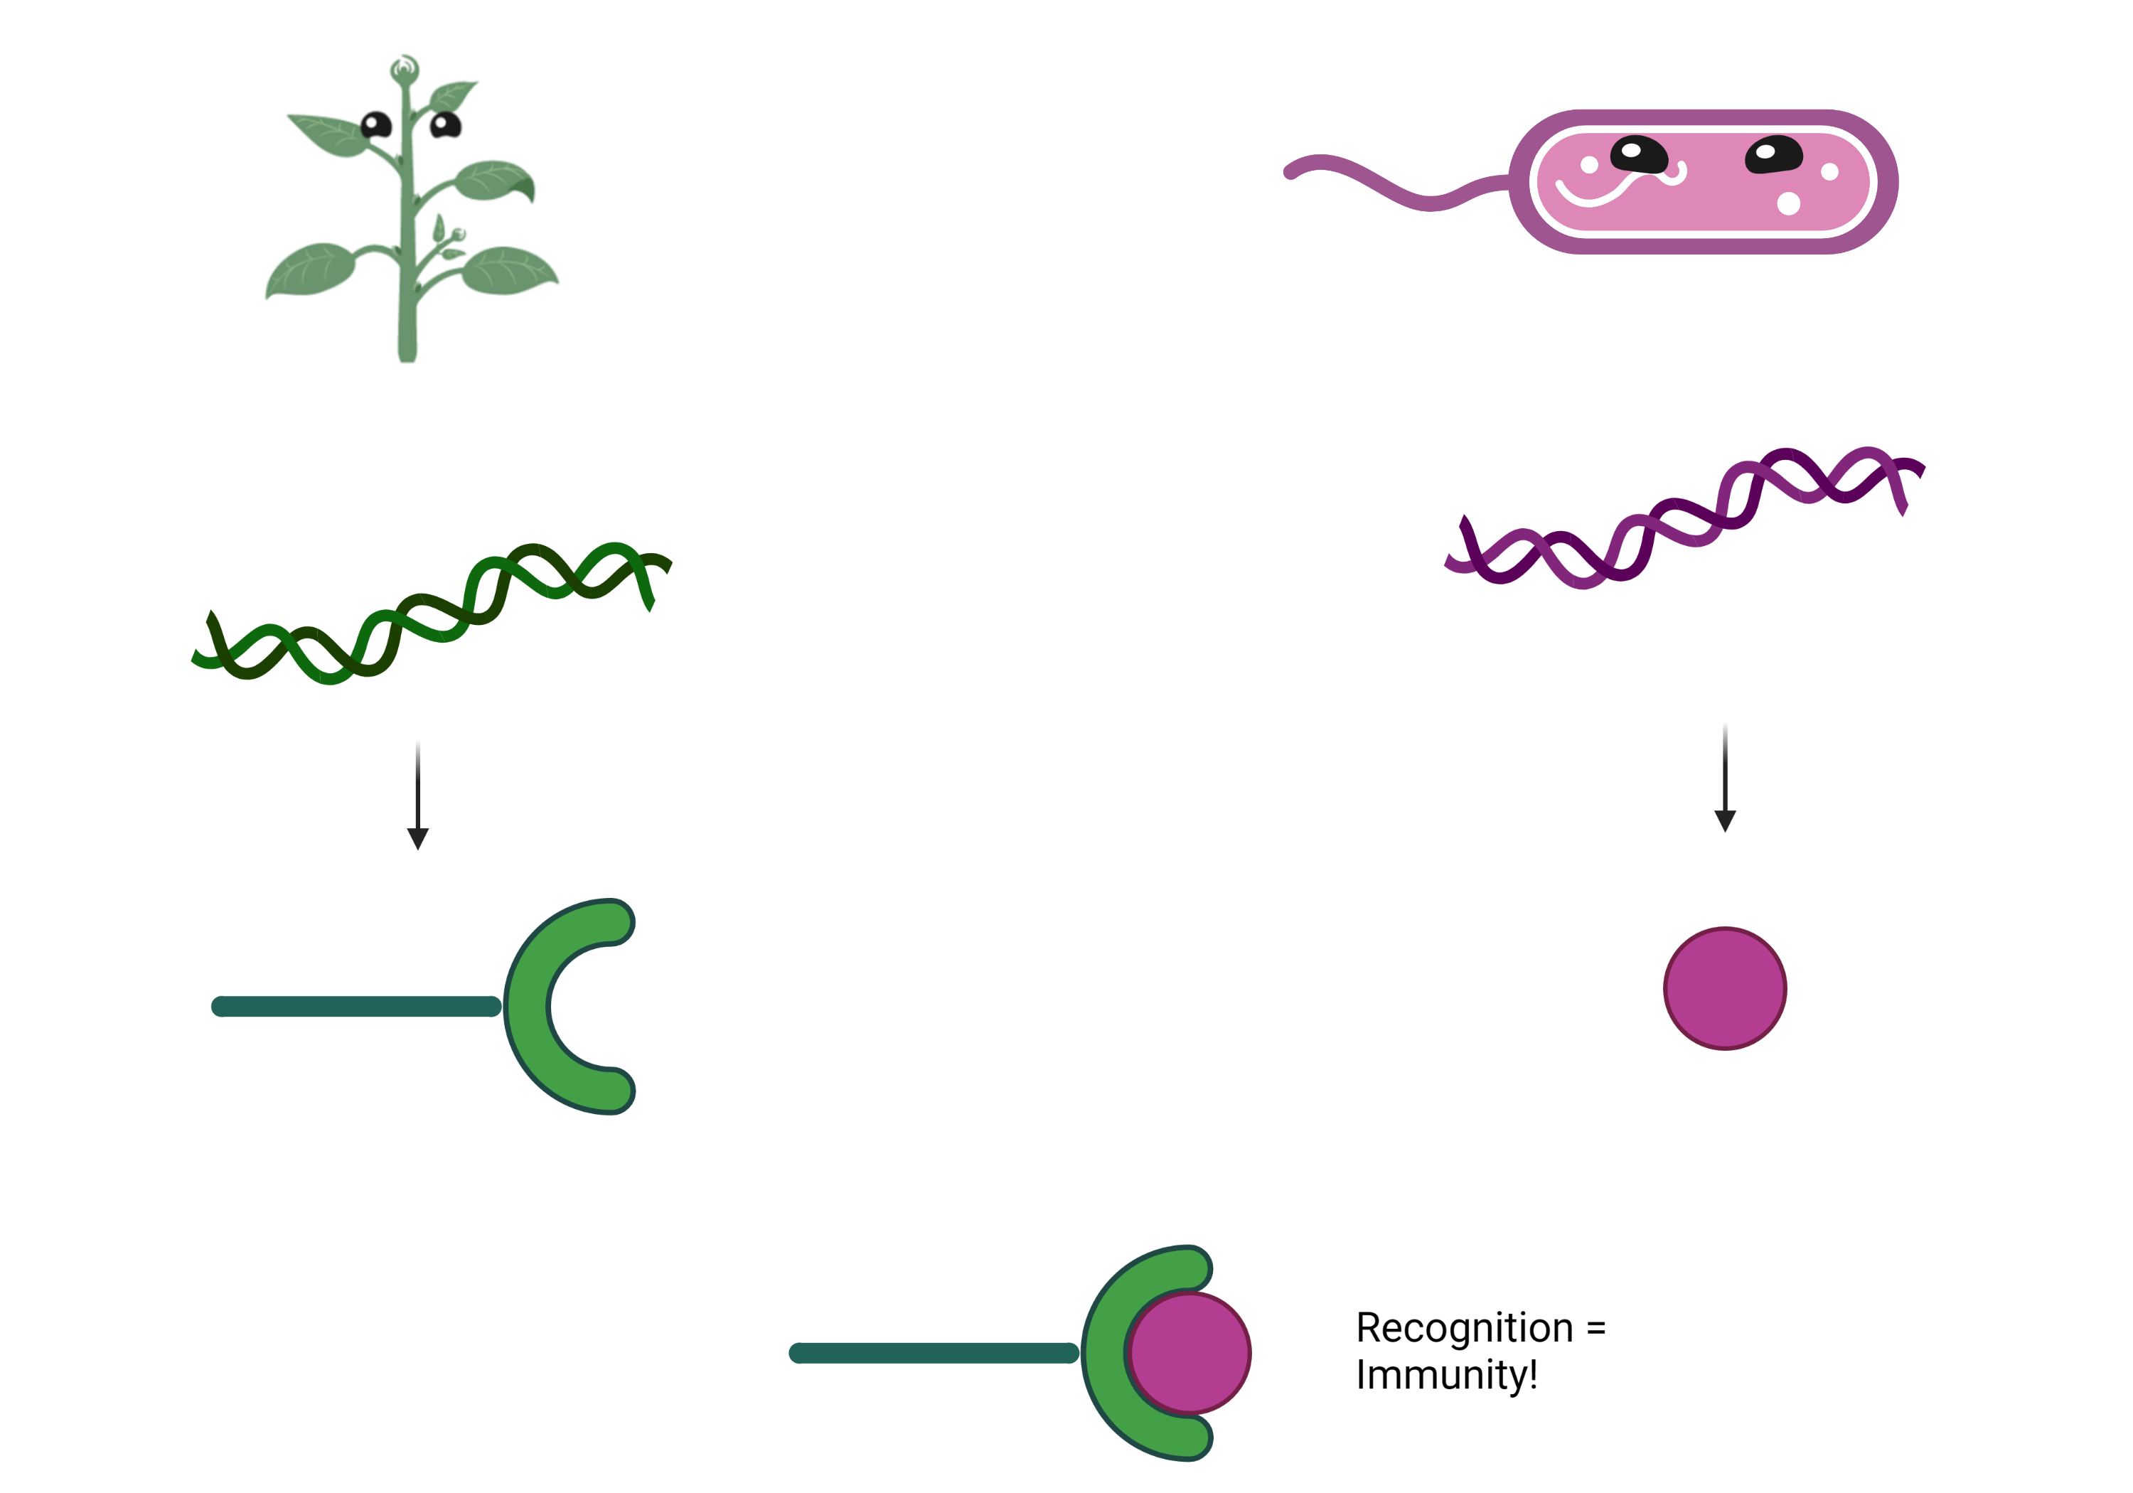

Slide 12
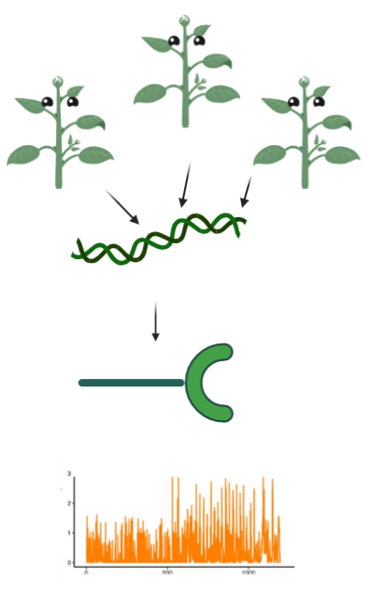
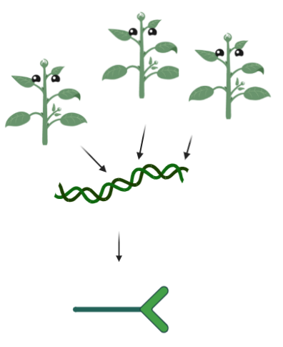

Slide 13
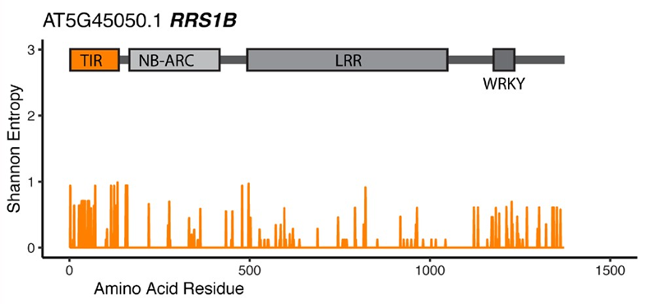
Diversity
Diversity
DNA sequence
DNA sequence

Slide 14
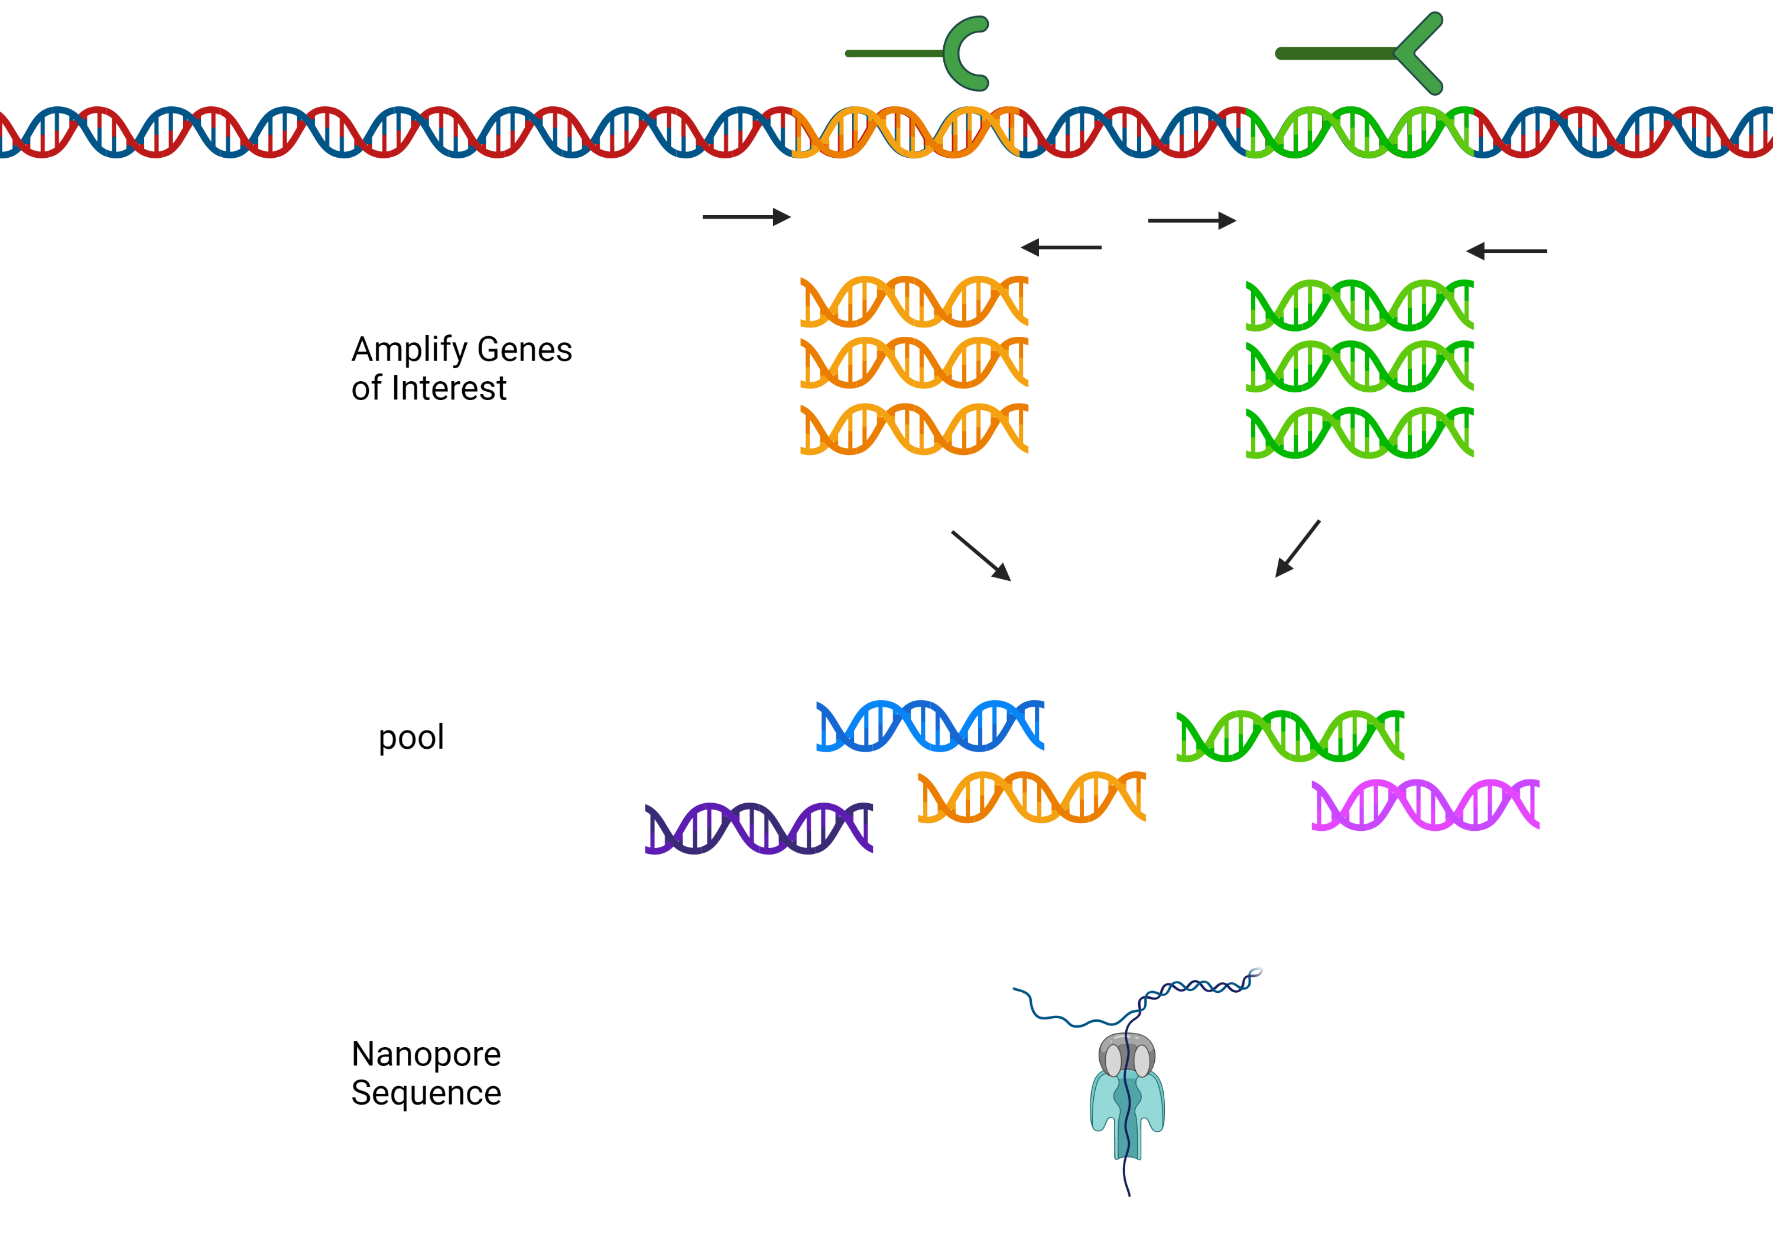

Slide 15
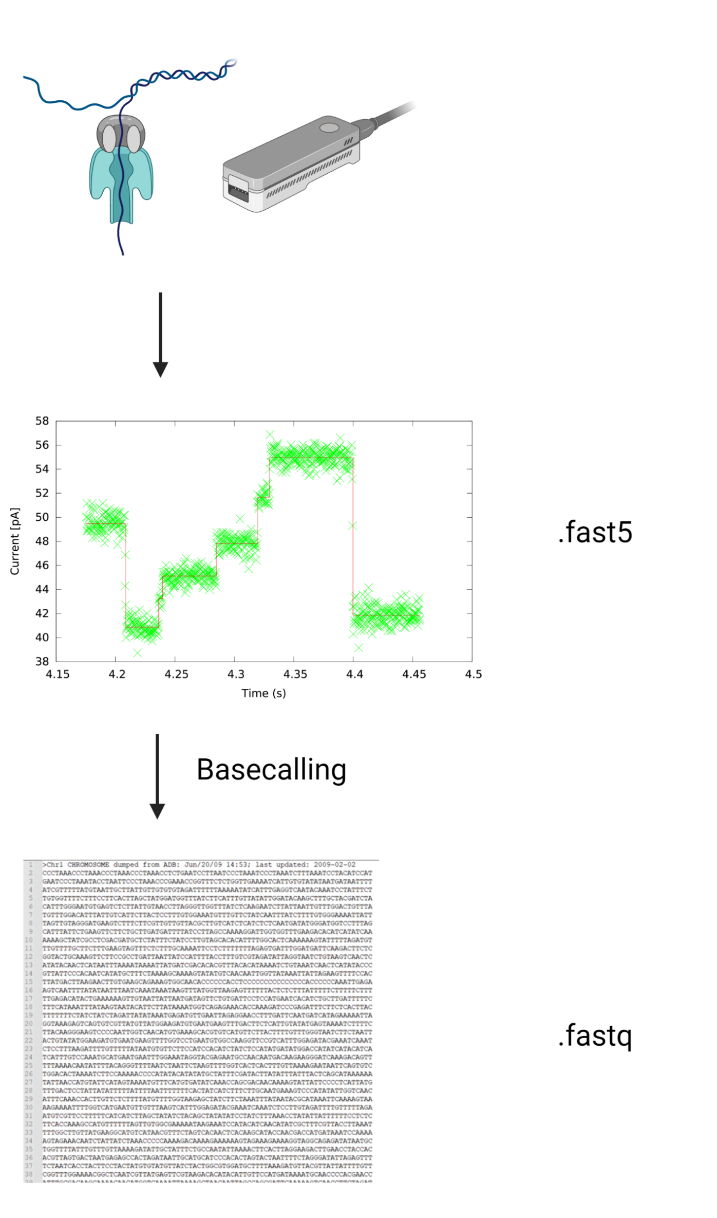

Slide 16
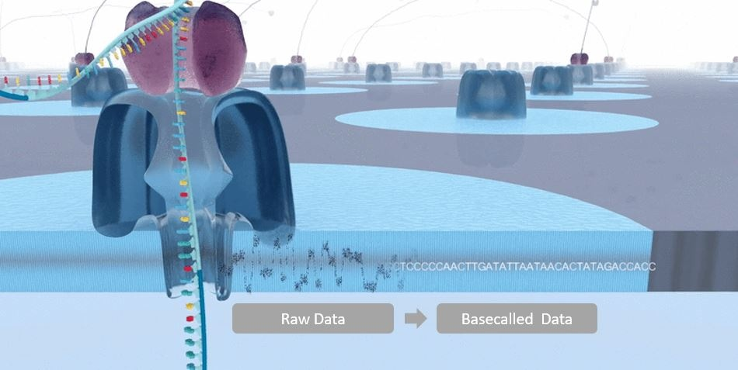
Basecalling
Notes:
Basecalling is the process of converting the electrical signals generated by a DNA or RNA strand passing through the nanopore into the corresponding base sequence of the strand. The general data flow in a nanopore sequencing experiment is shown below
The production version of Oxford Nanopore basecallers convert raw signal data to basecalls using algorithms that incorporate bi-directional Recurrent Neural Networks (RNNs). A neural network models processes that occur inside the human brain. The network contains nodes arranged in layers, which carry out computations. Neural networks receive and process data, but crucially, they have the ability to 'learn' and improve their predictions for the output over time. Neural networks have been successfully used for diverse applications like pattern recognition (such as handwritten characters, speech recognition), or predicting trends over time. A recurrent neural network is a class of neural networks in which the output is dependent on past computations. An RNN keeps an internal memory of previously-seen data, so each new computation can use information from several preceding computations. A bi-directional RNN can set data in the context of what comes both before and after in the signal.

Slide 17
Time to process some sequenced reads!
tinyurl.com/nuevagenome

Slide 18
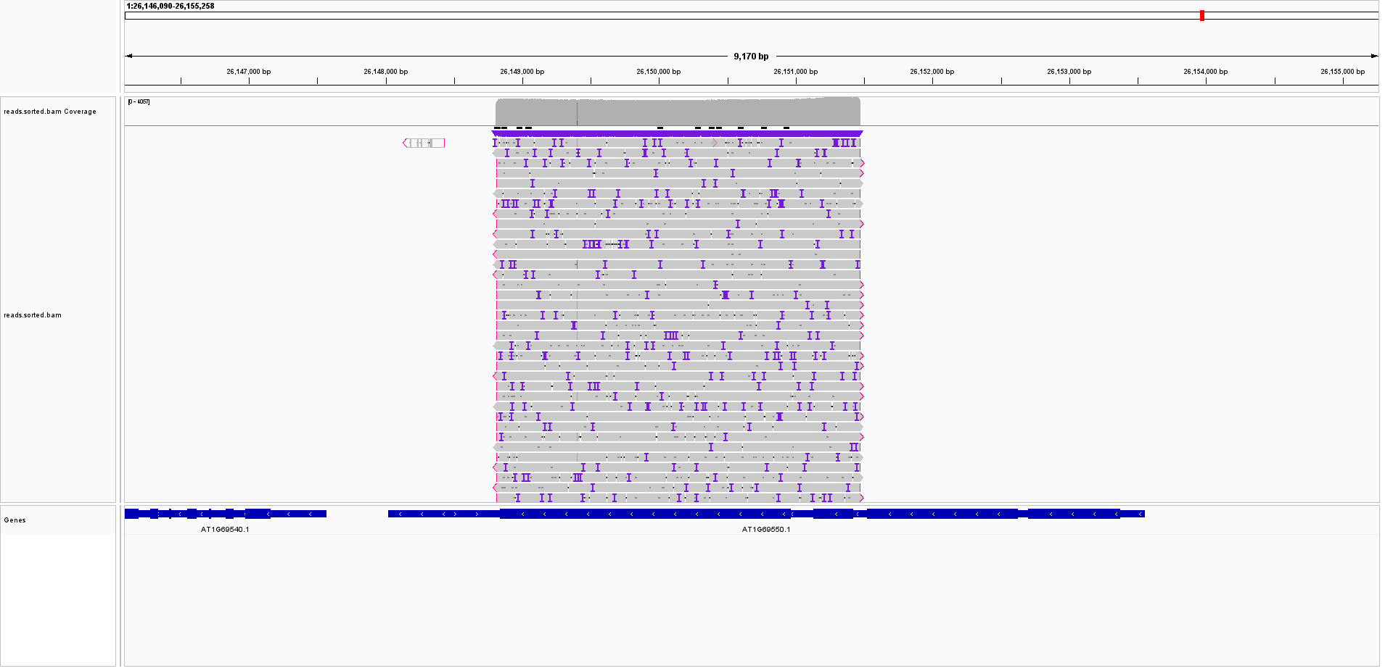

Slide 19
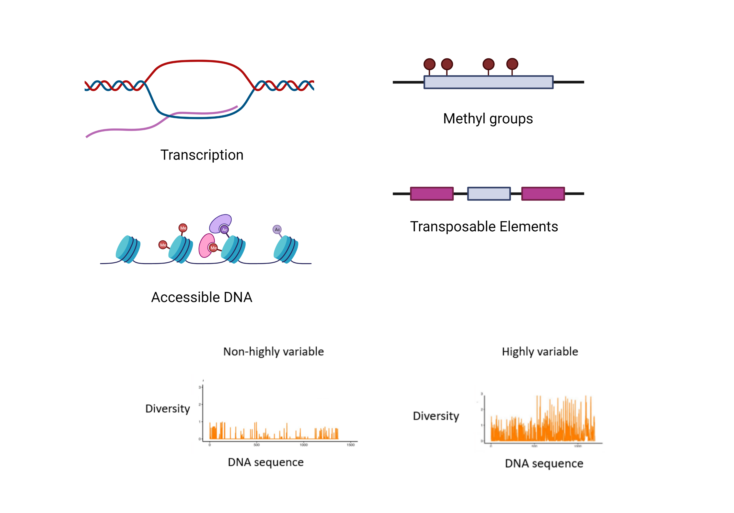
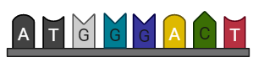
What other information can we evaluate?
Mutation rate

Slide 20
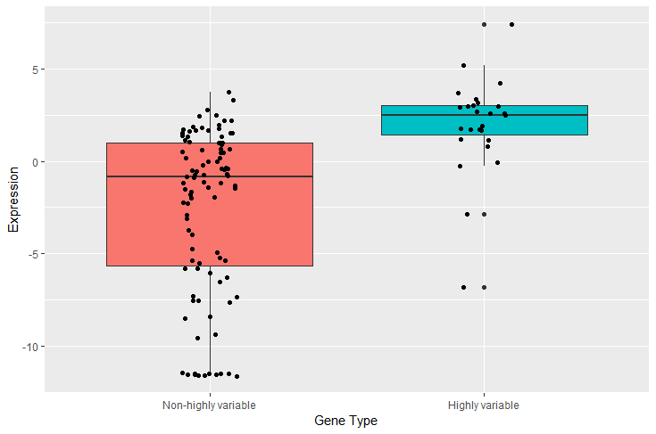
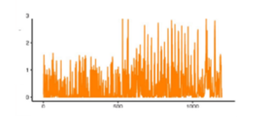
Highly variable immune receptors are expressed more than non-highly variable immune receptors

Slide 21
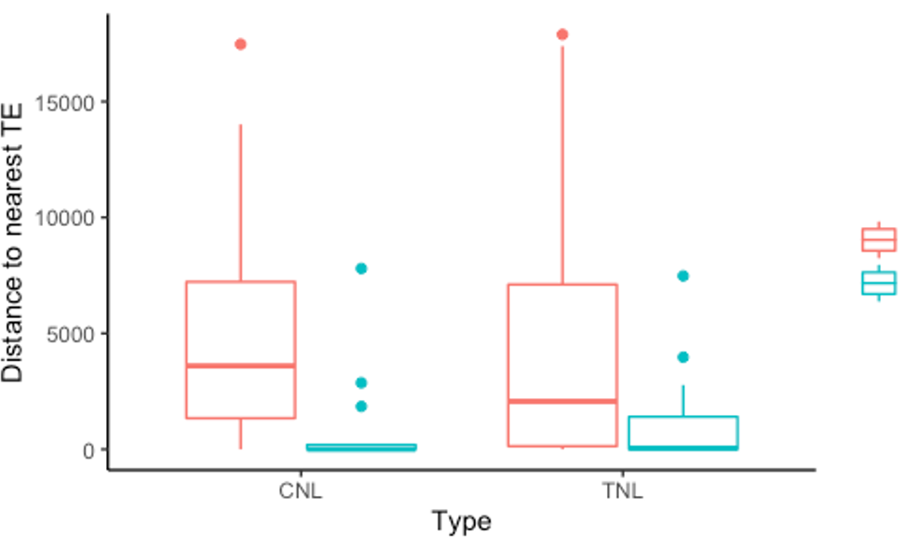
Highly variable immune receptors are closer to transcriptional elements than non-highly variable immune receptors
Non-highly variable
Highly variable

Slide 22
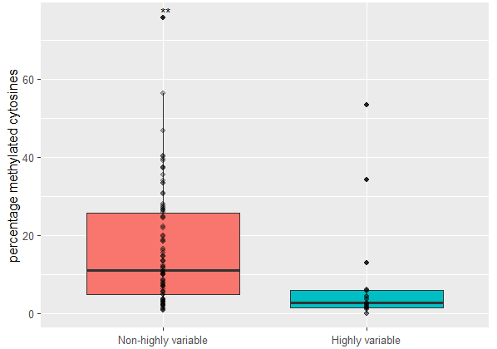
Highly variable immune are more methylated than non-highly variable immune receptors

Slide 23
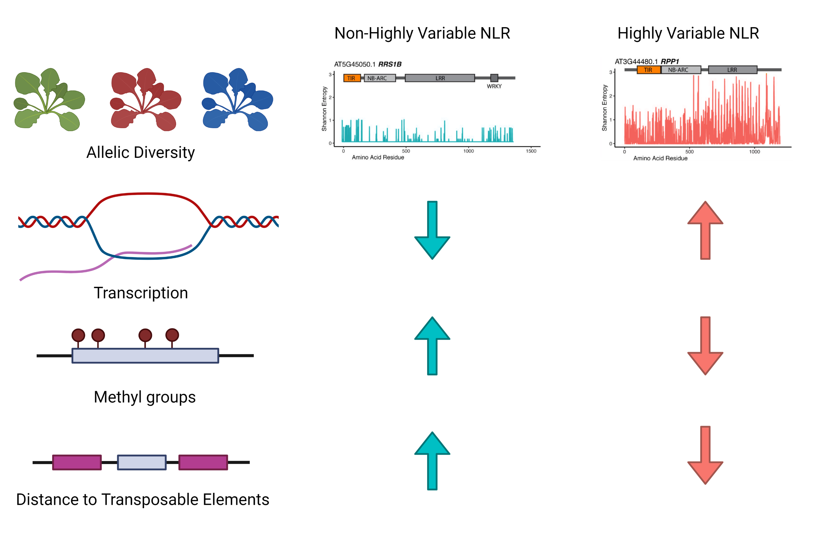
An individual’s methylation status, expression, and TE distance are correlated with intraspecies allelic diversity.

Slide 24

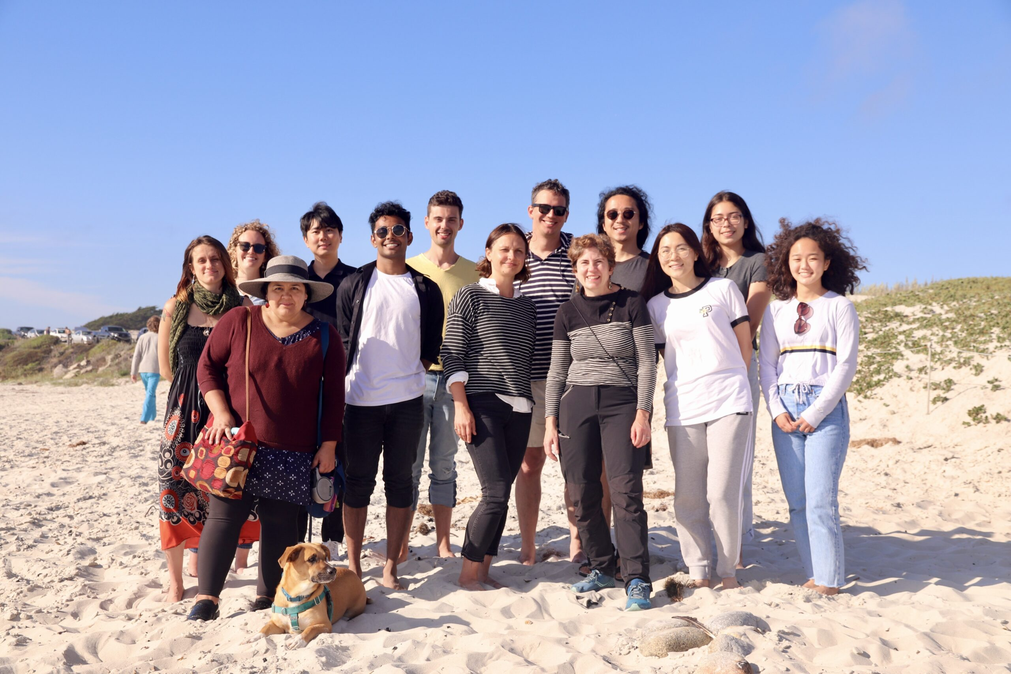


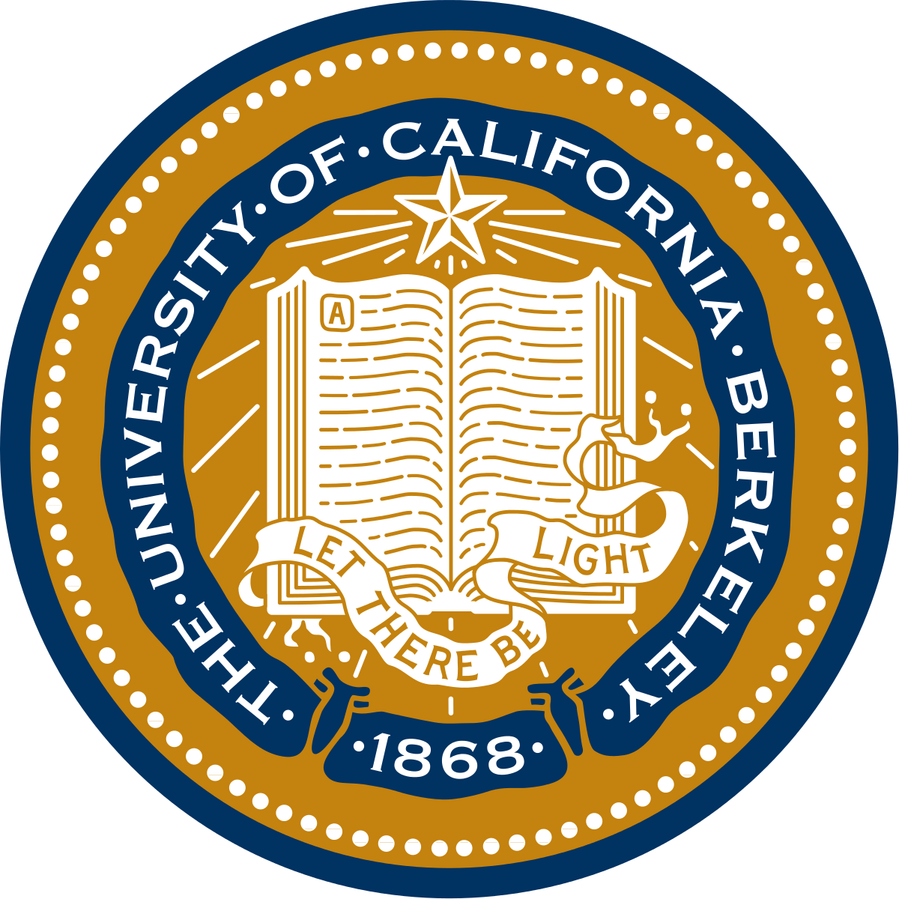

@chandler_suth
chandlersutherland@berkeley.edu

